Slide 1

Comparing Sustainable Development Aid and Need
Isaac Liu

Slide 2
Motivation
Debate about efficacy of foreign aid
If aid is to be effective, a precondition is efficient allocation
Possible Principle of Need
One means of measurement: absolute deficit on indicators
Not necessarily normative, but descriptive, although some insight into plausibility
What does the allocation say about donor beliefs of efficacy?

Slide 3
Literature on ODA Aid and Need
Poverty:
Collier and Dollar (1999): Poverty Efficient allocation of aid does not correspond well to actual
Account for growth in models
MDGs
Theile et al (2007): Non-linear models and controls
Undernourishment, HIV/AIDs prevalence inform aid allocation, other hunger, ed, health, sanitation, environment metrics do not
Sectors
Food aid driven by demand and supply (Qian and Nunn 2015)
Health aid linked to child/infant mortality, HIV (Lee and Lim 2014)
Water mismatch (UN Water 2017)
High gender inequality leads to targeted aid (Dreher et al. 2015)
Kasuga (2008): rank analysis: food, health, STD control aid matched well, education and debt relief did not
Contribution: Priorities of the SDG Era (Infrastructure, Climate, Institutions), New Data, Unique Index, Focus on Disbursements

Slide 4



Data
Panel: 2012-2017, all countries for which aid data is available
Aid: OECD SDG Financing Lab
Development Assistance Committee Creditor Reporting System
Machine learning matches projects to one/more SDGs
ODA Disbursements from All Donors
Bilateral and multilateral (much bilateral unspecified, however)
Need: World Bank Data, UNStat
Separate access for UN HDI Gender Inequality Index and WB Women, Business, and the Law Index

Slide 5
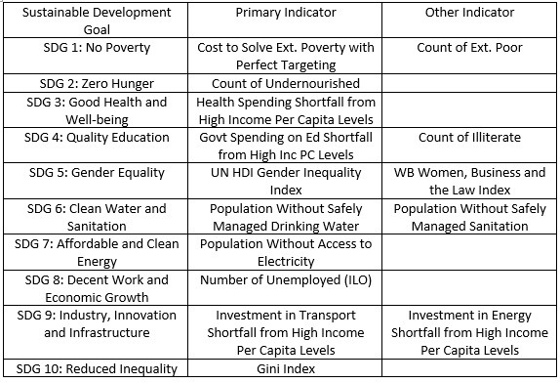
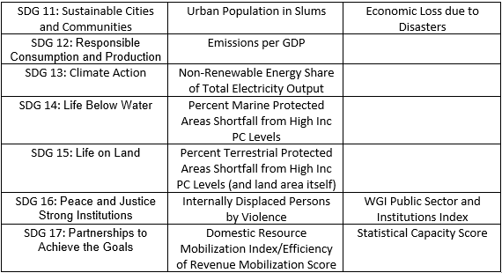
Indicators
Choose indicators to get absolute scale of the problem.

Slide 6
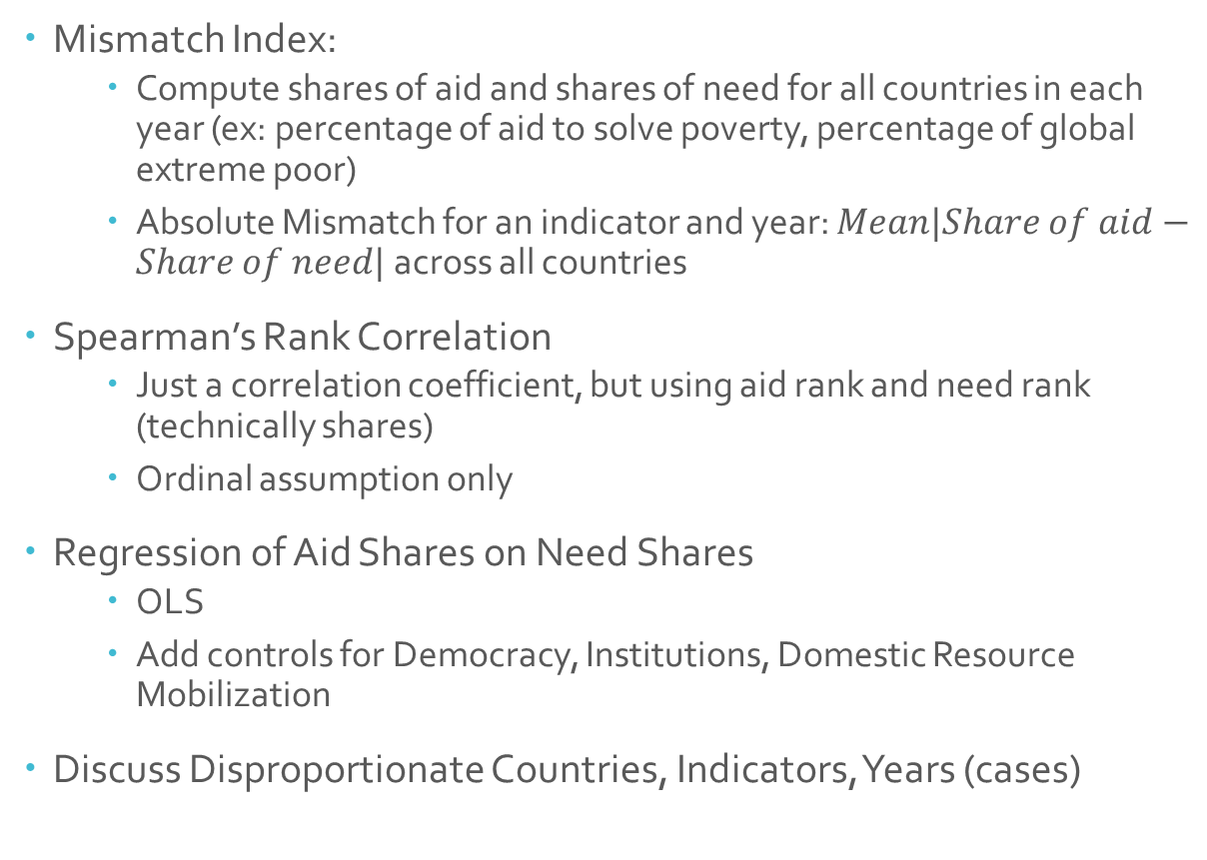
Methodology
Mismatch Index:
Compute shares of aid and shares of need for all countries in each year (ex: percentage of aid to solve poverty, percentage of global extreme poor)
Absolute Mismatch for an indicator and year: $Mean|Share of aid−Share of need|$ across all countries
Spearman’s Rank Correlation
Just a correlation coefficient, but using aid rank and need rank (technically shares)
Ordinal assumption only
Regression of Aid Shares on Need Shares
OLS
Add controls for Democracy, Institutions, Domestic Resource Mobilization
Discuss Disproportionate Countries, Indicators, Years (cases)

Slide 7
Comparison: Mean AMM
By Indicator

Slide 8
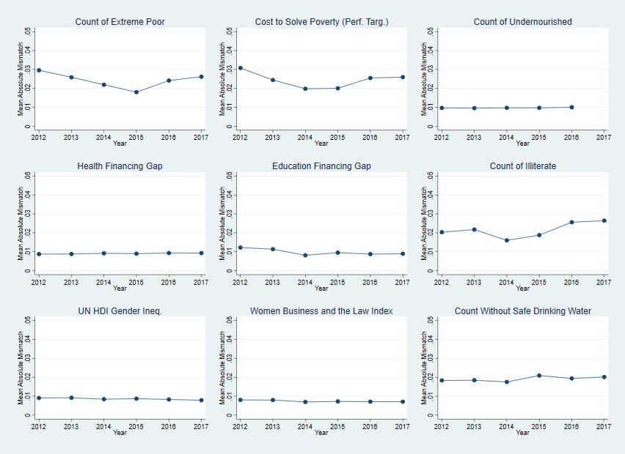

Slide 9
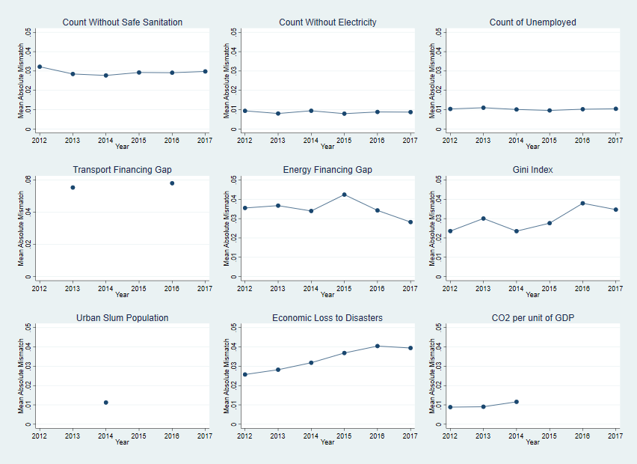

Slide 10
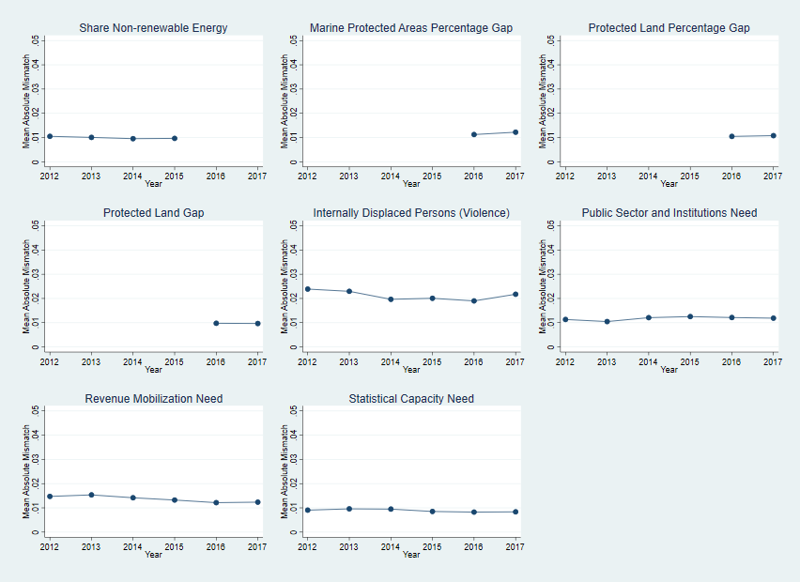

Slide 11
Worldwide AMM
All Indicators, Presented with Equal Weight on Each SDG

Slide 12
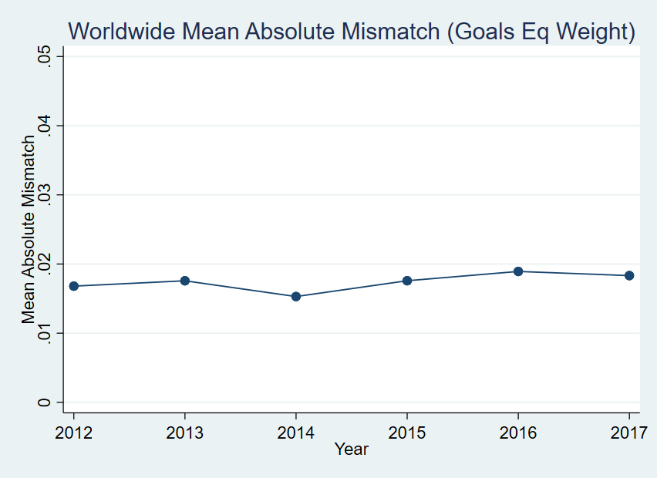
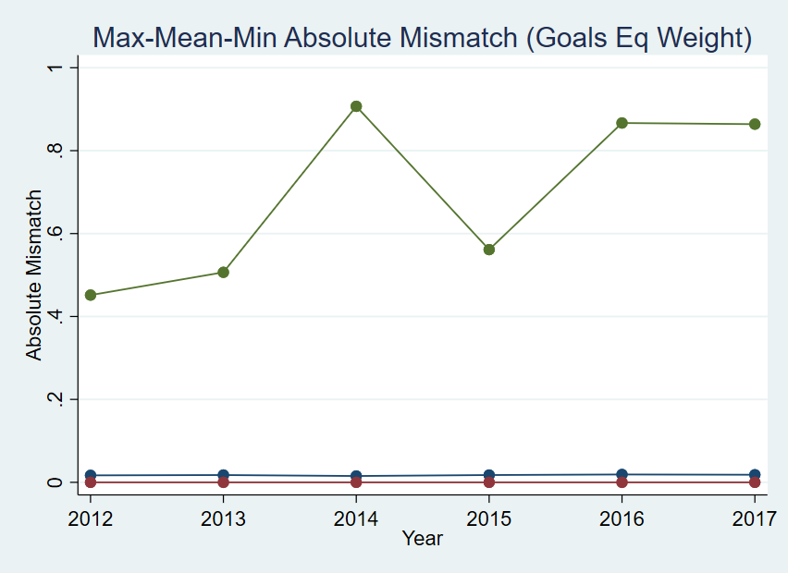

Slide 13
Spearman Correlation Coefficients
By Indicator

Slide 14
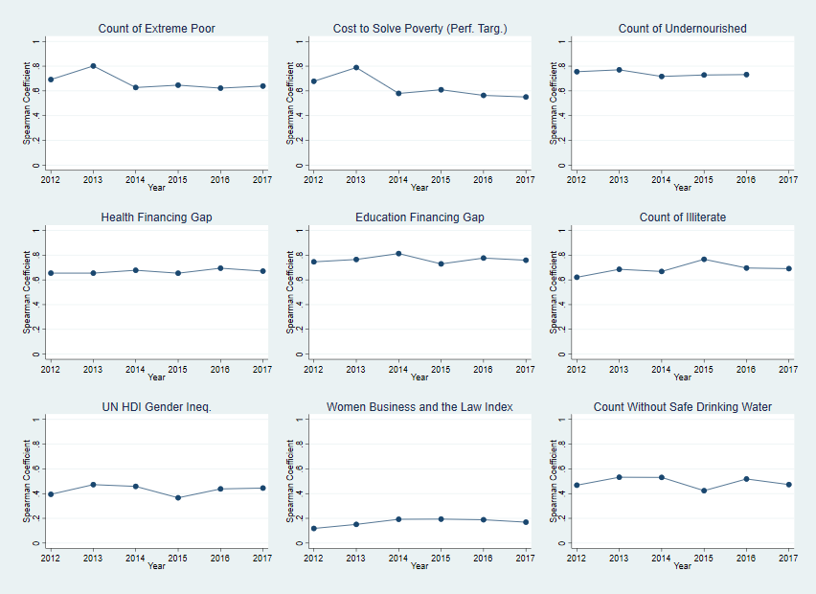

Slide 15
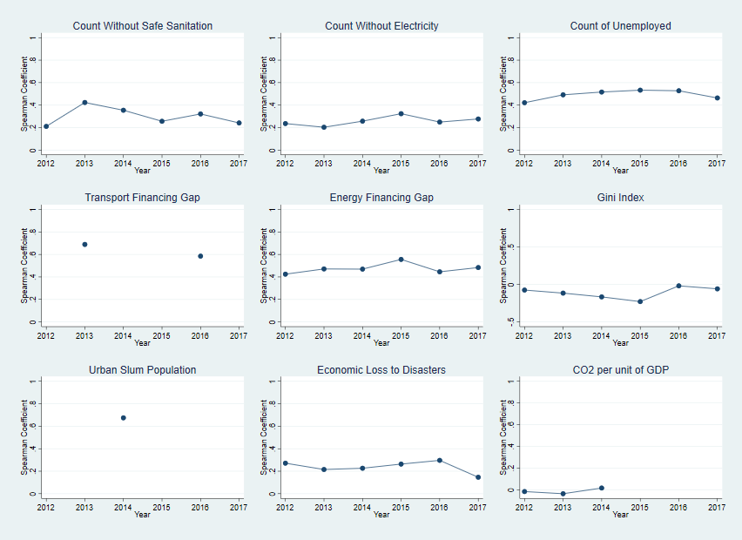

Slide 16
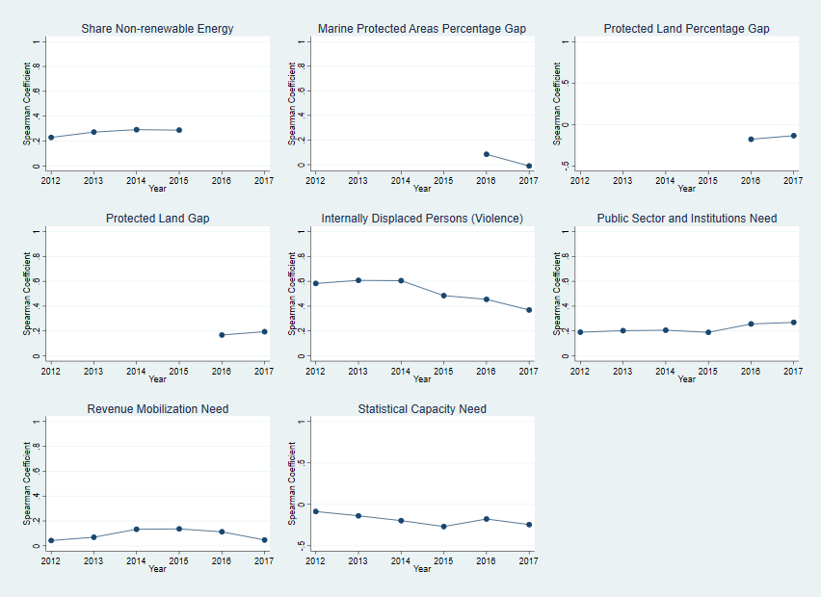

Slide 17
Regressions
Most indicators have a significant and positive sign
Exceptions: Gini Index, CO2 per GDP, Marine protected areas, Governance Indicators, Nonrenewables
Negative relationship between aid and protected land gap (protected land may actually mean more maintenance costs and more aid)
Slum population linked to urban development aid only with controls
Institutions, DRM occasionally matter, democracy does not, although these could be collinear
Institutions are significant for poverty, electricity, unemployment
Food and disaster aid linked to revenue mobilization
For health strong institutions decreases aid, but revenue mobilization increases
Democracy matters only for gender aid, extremely small effect

Slide 18
Disproportionate Country Analysis
Population-weighting nature: China and India receive relatively little on: poverty, energy, health, hunger, sanitation (CN), pop w/o electricity (IN), urban slums (CN), transport, education, unemployment
Poverty: underfunded Brazil, DRC, Indonesia, overfunded Colombia, Ghana, Tanzania (varies by year)
Middle income nations in general show large disparity
Lag of adjustment to middle income status by donors
(Relative) Aid darlings: Turkey, Vietnam, Egypt, Afghanistan
Jordan: large water/marine allocations, Red-Dead Project
Egypt- climate aid, 2012, 2014 (Arab Spring?)
Brazil
Protected lands gap metric: lots prot. land, lots of aid
Colombia: large loss due to disasters, little aid

Slide 19
Summary
Mismatch shows very good fit for later goals and food, health and education, a fair fit for poverty, poorest fit for middle goals (growth, inequality, energy, sanitation)
Spearman coefficients show best fits for low number goals, poorer fits for higher numbered ones. Gender and governance fit far worse than mismatch (const. indices). Sanitation, transport better fit. Negative coefficient for CO2.
Overall low number goals excepting poverty best fits, middle and later goals show poorer fits (exception of IDPs), and gender, governance, and CO2 look poor in rank but not mismatch terms
Regressions: mixed results. OLS fit is fairly good. Institutions and revenue mobilization matter for a few goals, democracy does not
No clear trend in mismatch over time, Spearman coefficients appear to be decreasing if anything (IDPs, Econ Loss to Disasters, Statistical Capacity)
Importance of adjusting allocations for middle income countries, more consideration of population to inform aid (eq. sovereignty?)

Slide 20
Questions and Future Directions
Weight Gini, governance, gender indices by population
Not very interpretable
Interpolate (and/or extrapolate) missing data, esp. transport, energy. Can even use years outside of the 2012-2017 range
Preliminarily analysis suggests this does not lead to radically different results, except for energy financing and disaster relief
Mismatch as percent of total share for each country (1% of all aid has different meaning for small v. large recipient)
WB and European Commission Aid Allocation Formulas
Need to complete literature review
Country or sector level analysis
Test model fit before/after SDGs (Chow)
Maternal/child mortality (number of deaths), GDP per capita growth inclusion as indicators (data availability, non-intuitive)

Slide 21
Extra Results

Slide 22
Summary Statistics (low data availability for slum population, transport)
 | mean | sd | count
SI.POV.GINI | 39.81255 | 8.022751 | 263
EN.ATM.CO2E.PP.GD.KD | .2392621 | .1796158 | 401
VC.IDP.TOCV | 717515.8 | 1369293 | 302
extPoorCt | 2944790 | 8112045 | 263
costSolvePov | 1599012 | 4630788 | 263
illiterate | 7053372 | 1.50e+07 | 208
noSafeWater | 1.57e+07 | 3.09e+07 | 306
noSafeSan | 3.10e+07 | 8.16e+07 | 246
noElec | 6977038 | 2.04e+07 | 840
uSlumPop | 9039102 | 2.38e+07 | 83
unemployedCt | 1110423 | 4011330 | 768
NRenShare | -.3342274 | .342943 | 564
NPSI | .3886957 | .0950039 | 460
NRM | .3113044 | .1001221 | 460
NSCS | .3486855 | .1654614 | 825
HfinGap | 1.23e+11 | 4.63e+11 | 783
EfinGap | 5.39e+10 | 1.75e+11 | 429
PLandPGap | .0871015 | .0744512 | 276
PLandGap | 42953.84 | 89855.78 | 272
PMrnPGap | .1309126 | .0433065 | 205
TfinGap | 1.14e+10 | 3.03e+10 | 50
EnfinGap | 9.46e+09 | 3.92e+10 | 202
SN_ITK_DEFCN Value | 6.517368 | 23.14222 | 570
VC_DSR_GDPLS Value | 1.64e+09 | 1.29e+10 | 318
polity2 | 3.176136 | 5.638236 | 704
GI | .4585024 | .1373504 | 633
WBLIndex | 32.60662 | 15.4838 | 816

Slide 23
Max-Mean-Min AMM
By Indicator

Slide 24
